Slide 1
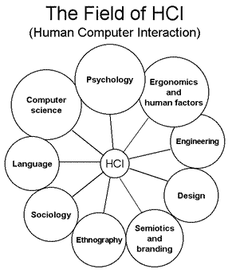
UNIT – III
Design process

Slide 2
Obstacles in the Development Path
Gould (1988) general observations about design:
Nobody ever gets it right the first time.
Development is chock-full of surprises.
Good design requires living in a sea of changes.
Making contracts to ignore change will never eliminate the need for change.
Even if you have made the best system humanly possible, people will still make
mistakes when using it.
Designers need good tools.
You must have behavioural design goals like performance design goals.

Slide 3
Pitfalls in the Development Path
No early analysis and understanding of the user’s needs and expectations.
A focus on using design features or components that are “neat” or “glitzy.”
Little or no creation of design element prototypes.
No usability testing.
No common design team vision of user interface design goals.
Poor communication between members of the development team.

Slide 4
Designing for People: The Five Commandments
1) Gain a complete understanding of users and their tasks.
2) Solicit early and ongoing user involvement.
3) Perform rapid prototyping and testing.
4) Modify and iterate the design as much as necessary.
5) Integrate the design of all the system components.

Slide 5
USABILITY
      Shackel (1991) simply defined usability as
      “ The capability to be used by humans easily and effectively, where,
      easily = to a specified level of subjective assessment,
      effectively = to a specified level of human performance.”

Slide 6
Usability Assessment in the Design Process
Usability assessment should begin in the early stages of the product development cycle and should be continually applied throughout the process.
The assessment should include the user’s entire experience, and all the product’s important components.
Common Usability Problems
1. Ambiguous menus and icons.
2. Languages that permit only single-direction movement through a system.
3. Input and direct manipulation limits.
4. Highlighting and selection limitations.
5. Unclear step sequences.
6. More steps to manage the interface than to perform tasks.
7. Complex linkage between and within applications.
8. Inadequate feedback and confirmation.
9. Lack of system anticipation and intelligence.
10. Inadequate error messages, help, tutorials, and documentation.

Slide 7
Some Practical Measures of Usability
Are people asking a lot of questions or often reaching for a manual?
Are frequent exasperation responses heard?
Are there many irrelevant actions being performed?
Are there many things to ignore?
Do a number of people want to use the product?

Slide 8
Some Objective Measures of Usability
At better than some required level of performance (for example, in terms of speed and errors)?
By some required percentage of the specified target range of users?
Within some required proportion of the range of usage environments?
How learnable is the interface? Can the interface be learned:
Within some specified time from commissioning and start of user training?
Based on some specified amount of training and user support?
Within some specified relearning time each time for intermittent users?

Slide 9
How flexible is the interface? Is it flexible enough to:
Allow some specified percentage variation in tasks and/or environments beyond those first specified?
What are the attitudes of the users? Are they:
Within acceptable levels of human cost in terms of tiredness, discomfort, frustration, and personal effort?
Such that satisfaction causes continued and enhanced usage of the system?

Slide 10
The design team
Provide a balanced design team, including specialists in:
Development
Human factors
Visual design
Usability assessment
Documentation
Training

Slide 11
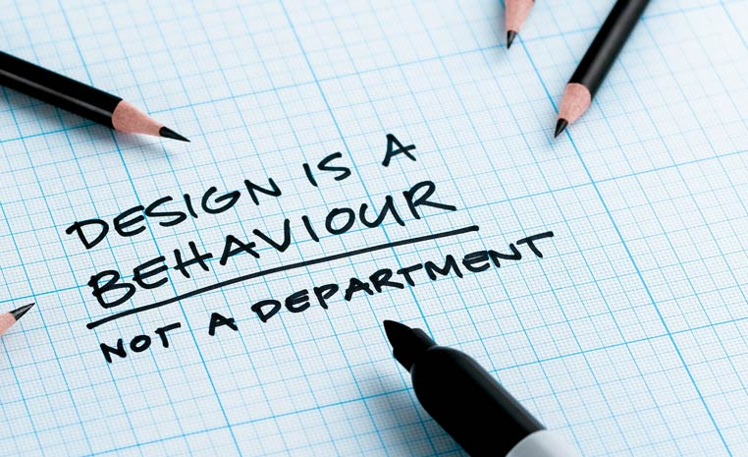

Slide 12
Human interaction with computers

Slide 13
Step 1
Know Your User or Client

Slide 14
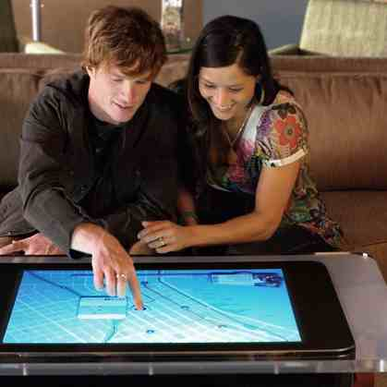
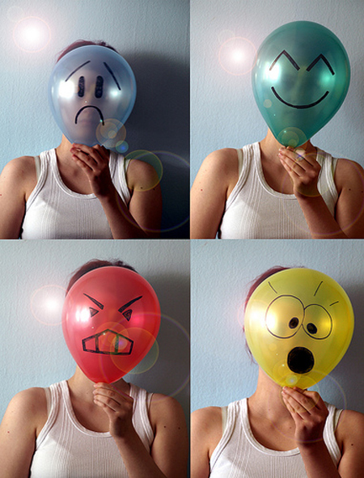
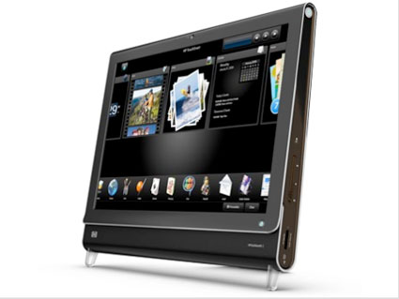
From Designers Perspective – Understanding the User
Understand how people interact with computers.
Understand the human characteristics important in design.
Identify the user’s level of knowledge and experience.
Identify the characteristics of the user’s needs, tasks, and jobs.
Identify the user’s psychological characteristics.
Identify the user’s physical characteristics.
Employ recommended methods for gaining understanding of users.

Slide 15
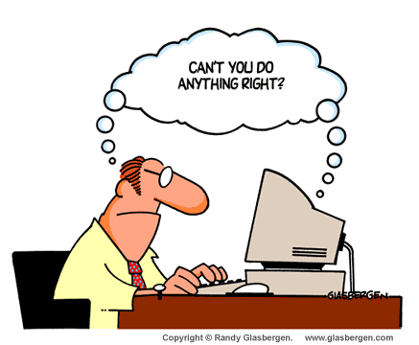
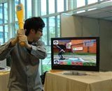
Understanding How People Interact
with Computers

Slide 16


Why People Have Trouble with Computers
Little training in usability
Designers what they do, feel
as error-prone.
Knowledge of the computer system that users do not possess.

Slide 17
What makes a system difficult to use in the eyes of its user?
Use of jargon
  Filespec, abend, segment, boot, proliferate
Non-obvious design
Fine distinctions.
  Pressing the Enter key “in the wrong way.”
Disparity in problem-solving strategies.
  People learn best by doing. “error-correcting” or
  “trial and error”
Design inconsistency
  “save” and “keep,” “write” and “list.”

Slide 18
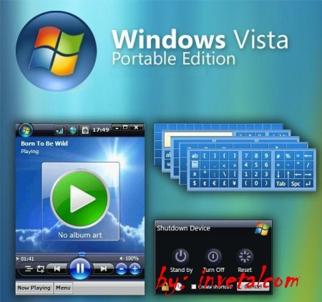
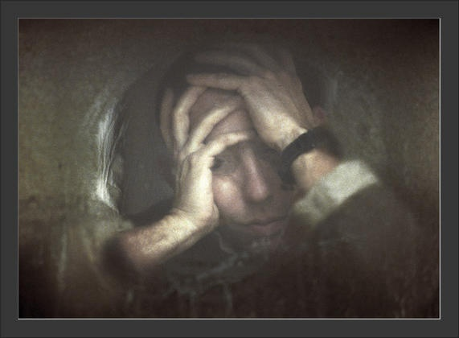
Responses to Poor Design
Psychological.
Confusion
Annoyance.
Frustration
Panic or stress.
Boredom.
Physical.
Abandonment of the system.
Partial use of the system.
Indirect use of the system
Modification of the task.
Misuse of the system.
Direct programming.
Compensatory Activity

Slide 19

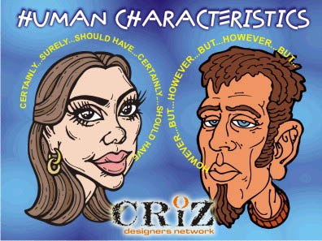
Important Human Characteristics in Design

Slide 20


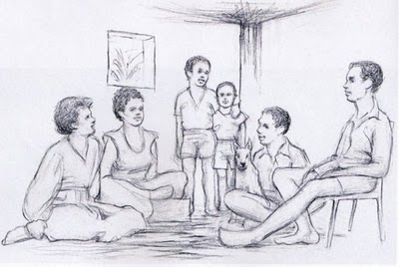
Perception
Awareness and Understanding of the elements and Objects of our environment through the physical sensation of our various senses, including sight, sound, smell, and so forth.
Proximity (relation)
Similarity
Matching patterns
Succinctness
Closure
Unity
Continuity
Balance
Expectancies
Context
Signals versus noise
Perception is influenced, in part, by experience. in part, by experience.

Slide 21


Memory
Long Term
Short Term
Other general ways to reduce user memory loads, reduce the need for mental integration, and expand working memory, thus enhancing system usability include:
Presenting information in an organized, structured, familiar, and meaningful way.
Placing all required information for task performance in close physical proximity.
Giving the user control over the pace of information presentation.

Slide 22

Sensory Storage
Sensory storage is the buffer where the automatic processing of information collected
from our senses takes place.
Cocktail party effect: To focus one's listening attention on a single talker among a mixture of conversations and background noises, ignoring other conversations
Enables us to talk in a noisy place.
Design the interface so that all aspects and elements serve a definite purpose. Eliminating interface noise will ensure that important things will be less likely to be missed.

Slide 23
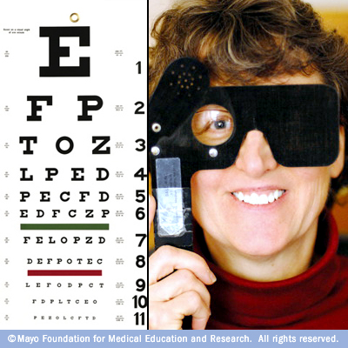
Visual Acuity
The capacity of the eye to resolve details is called visual acuity.
3213123
54321212345
6543211123456
765432101234567
6543211123456
54321212345
3213123
Size of area of optimum visual acuity on a screen.

Slide 24
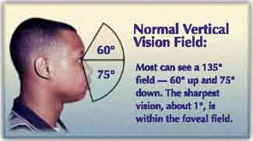
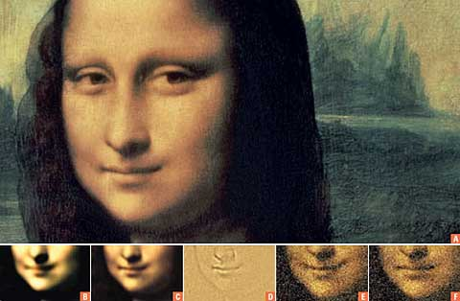
Foveal and Peripheral Vision
Foveal vision is used to focus directly on something;
Peripheral vision senses anything in the area surrounding the location we are looking at, but what is there cannot be clearly resolved because of the limitations in visual acuity just described.

Slide 25
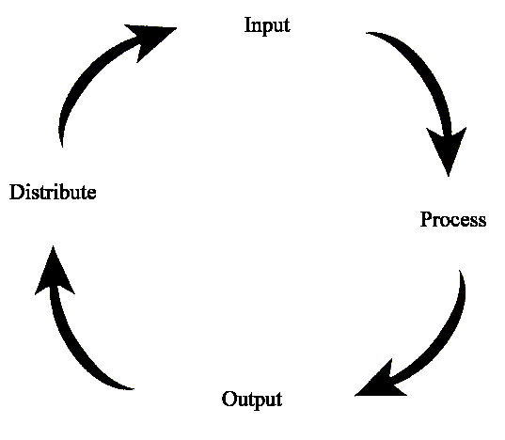
Information Processing
Information processing is the change (processing) of information in any manner detectable by an observer.
As such, it is a process which describes everything which happens (changes) in the universe, from the falling of a rock (a change in position) to the printing of a text file from a digital computer system

Slide 26
Mental Models
A mental model is an explanation of someone's thought process about how something works in the real world.
It is a representation of the surrounding world, the relationships between its various parts and a person's intuitive perception about their own acts and their consequences.
Our mental models help shape our behaviour and define our approach to solving problems (think personal algorithm) and carrying out tasks.

Slide 27

Movement Control
Fitts’ Law (1954). This law states that:
“The time to acquire a target is a function of the distance to and size of the target.”
This simply means that the bigger the target is, or the closer the target is, the faster it will be reached. The implications in screen design are:
Provide large objects for important functions.
Take advantage of the “pinning” actions of the sides, top, bottom, and corners of the screen.

Slide 28
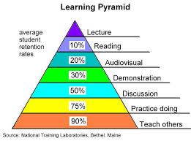
Learning
Learning can be enhanced if it:
Allows skills acquired in one situation to be used in another somewhat like it. Design consistency accomplishes this.
Provides complete and prompt feedback.
Is phased, that is, it requires a
person to know only the
information needed at that
stage of the learning process.

Slide 29


Skill
The goal of human performance is to perform skillfully. To do so requires linking inputs and responses into a sequence of action.
The essence of skill is performance of actions or movements in the correct time sequence with adequate precision.
It is characterized by consistency and economy of effort. Economy of effort is achieved by establishing a work pace that represents optimum efficiency.
System and screen design must permit
development of increasingly skillful
performance.

Slide 30
Individual differences
Individual differences complicate design because the design must permit people with widely varying characteristics to satisfactorily and comfortably learn the task or job, or use the Web site.
But technology now offers the possibility of tailoring jobs to the specific needs of people with varying and changing learning or skill levels.
Multiple versions of a system can easily be created. Design must provide for the needs of all potential users.

Slide 31
Human Considerations in Design
The User’s Knowledge and Experience
The User’s Tasks and Needs
The User’s Psychological Characteristics
The User’s Physical Characteristics

Slide 32
The User’s Knowledge and Experience
Computer Literacy: Highly technical or experienced, moderate computer experience, or none.
System Experience: High, moderate, or low knowledge of a particular system and its methods of interaction.
Application Experience: High, moderate, or low knowledge of similar systems.
Task Experience: Level of knowledge of job and job tasks.
Other Systems Use: Frequent or infrequent use of other systems in doing job.
Education: High school, college, or advanced degree.
Reading Level: Less than 5th grade, 5th–12th, more than 12th grade.
Typing Skill: Expert (135 WPM), skilled (90 WPM), good (55 WPM), average (40 WPM), or "hunt and peck" (10 WPM).
Native Language or Culture: English, another, or several.

Slide 33
The User’s Tasks and Needs
Type of System Use: Mandatory or discretionary use of the system.
Frequency of Use: Continual, frequent, occasional, or once-in-a-lifetime use of system.
Task or Need Importance: High, moderate, or low importance of the task being performed.
Task Structure: Repetitiveness or predictability of tasks being automated, high, moderate, or low.
Social Interactions: Verbal communication with another person required or not required.

Slide 34
Primary Training: Extensive or formal training, self-training through manuals, or no training.
Turnover Rate: High, moderate, or low turnover rate for jobholders.
Job Category: Executive, manager, professional, secretary, clerk.
Lifestyle: For Web e-commerce systems, includes hobbies, recreational pursuits, and economic status.

Slide 35
The User’s Psychological Characteristics
Attitude: Positive, neutral, or negative feeling toward job or system.
Motivation: Low, moderate, or high due to interest or fear.
Patience: Patience or impatience expected in accomplishing goal.
Expectations: Kinds and reasonableness.
Stress Level: High, some, or no stress generally resulting from task performance.
Cognitive Style: Verbal or spatial, analytic or intuitive, concrete or abstract.

Slide 36
The User’s Physical Characteristics
Age: Young, middle aged, or elderly.
Gender: Male or female.
Handedness: Left, right, or ambidextrous.
Disabilities: Blind, defective vision, deafness, motor handicap.

Slide 37
Human Interaction Speeds
Average Human Interaction Speeds
Reading
Prose text:- 250–300 words per minute (WPM).
Proofreading text on paper:- 200 WPM.
Proofreading text on a monitor:- 180 WPM.
Listening 150–160 WPM.
Speaking to a computer:- 105 WPM.
After recognition corrections:- 25 WPM.
Keying
Typewriter:-
Fast typist:- 150 WPM.
Average typist:- 60–70 WPM.

Slide 38
Computer:-
Transcription: 33 WPM.
Composition: 19 WPM.
Two finger typists:-
Memorized text: 37 WPM.
Copying text: 27 WPM.
Hand printing:-
Memorized text: 31 WPM.
Copying text: 22 WPM.

Slide 39
Step 2
Understand the Business Function

Slide 40
The general steps
Perform a business definition and requirements analysis.
Determine basic business functions.
Describe current activities through task analysis.
Develop a conceptual model of the system.
Establish design standards or style guides.
Establish system usability design goals.
Define training and documentation needs.

Slide 41
Contents
Business Definition and Requirements Analysis
Determining Basic Business Functions
Design Standards or Style Guides
SYSTEM Training and Documentation Needs

Slide 42
Business Definition and Requirements Analysis
Individual Face-to-Face Interview
• A one-on-one visit with the user to obtain information. It may be structured or somewhat open-ended.
Telephone Interview or Survey
• A structured interview conducted via telephone.
Traditional Focus Group
• A small group of users and a moderator brought together to verbally discuss the requirements.
Facilitated Team Workshop
• A facilitated, structured workshop held with users to obtain requirements information. Similar to the Traditional Focus Group.
Observational Field Study
• Users are observed and monitored for an extended time to learn what they do.

Slide 43
Requirements Prototyping
• A demo, or very early prototype, is presented to users for comments concerning functionality.
User-Interface Prototyping
• A demo, or early prototype, is presented to users to uncover user-interface issues and problems.
Usability Laboratory Testing
• Users at work are observed, evaluated, and measured in a specially constructed laboratory.
Card Sorting for Web Sites
• A technique to establish groupings of information for Web sites.
These are all Direct Methods

Slide 44
INDIRECT METHODS
MIS Intermediary
• A company representative defines the user’s goals and needs to designers and developers.
Paper Survey or Questionnaire
• A survey or questionnaire is administered to a sample of users using traditional mail methods to obtain their needs.
Electronic Survey or Questionnaire
• A survey or questionnaire is administered to a sample of users using e-mail or the Web to obtain their needs.
Electronic Focus Group
• A small group of users and a moderator discuss the requirements online using workstations.
Marketing and Sales
• Company representatives who regularly meet customers obtain suggestions or needs, current and potential.

Slide 45
Support Line
• Information collected by the unit that helps customers with day-to-day problems is analyzed (Customer Support, Technical Support, Help Desk, etc.).
E-Mail or Bulletin Board
• Problems, questions, and suggestions from users posted to a bulletin board or through e-mail are analyzed.
User Group
• Improvements are suggested by customer groups who convene periodically to discuss software usage.
Competitor Analyses
• A review of competitor’s products or Web sites is used to gather ideas, uncover design requirements and identify tasks.
Trade Show
• Customers at a trade show are presented a mock-up or prototype and asked for comments.

Slide 46
Other Media Analysis
• An analysis of how other media, print or broadcast, present the process, information, or subject matter of interest.
System Testing
• New requirements and feedback are obtained from ongoing product testing.
These are all Indirect Methods

Slide 47
Assignment 2
Determining Basic Business Functions
Design Standards or Style Guides

Slide 48
System Training and Documentation Needs
Training:
System training will be based on user needs, system conceptual design, system learning goals, and system performance goals.
Training may include such tools as formal or video training, manuals, online tutorials, reference manuals, quick reference guides, and online help.
Documentation:
System documentation is a reference point, a form of communication, and a more concrete design—words that can be seen and understood.
Creating documentation during the development progress will uncover issues and reveal omissions that might not otherwise be detected until later in the design process.

